Slide 1
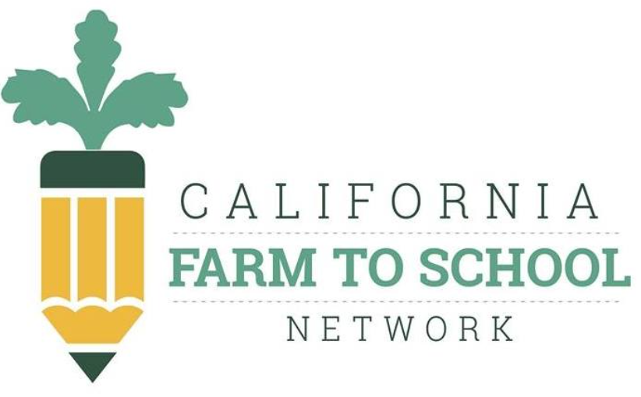

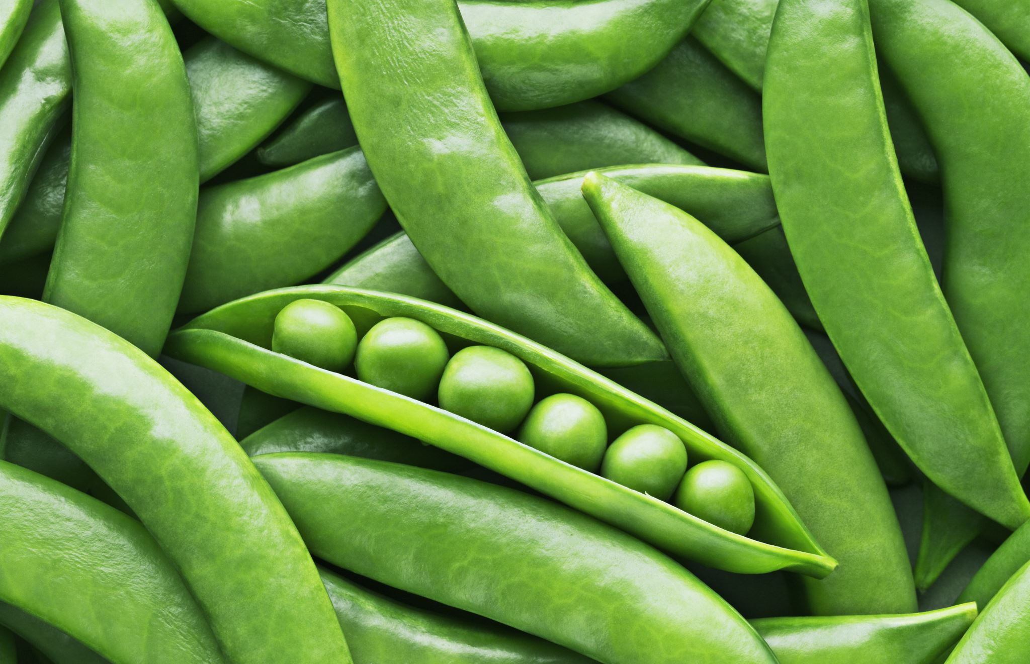
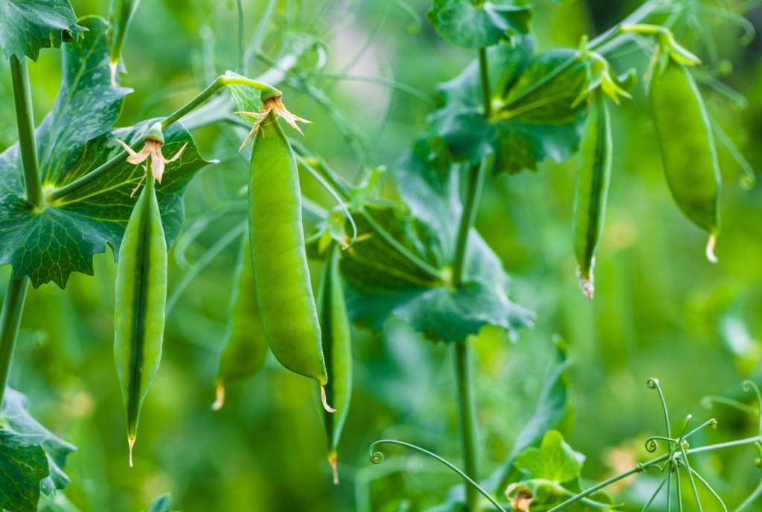
Sugar Snap Pea
A Virtual Field Trip
This Photo by Unknown Author is licensed under CC BY
Notes:
https://www.saveur.com/inventor-sugar-snap-pea/
https://smartyplants.com.au/2012/09/sugar-snap-peas/
https://harvestofthemonth.cdph.ca.gov/documents/Spring/Peas/Peas%20-%20Educator%27s%20Newsletter_Final.pdf
https://www.britannica.com/plant/pea
https://homeguides.sfgate.com/long-flower-picking-peas-58805.html
https://www.specialtyproduce.com/produce/Pea_Tendrils_3990.php

Slide 2
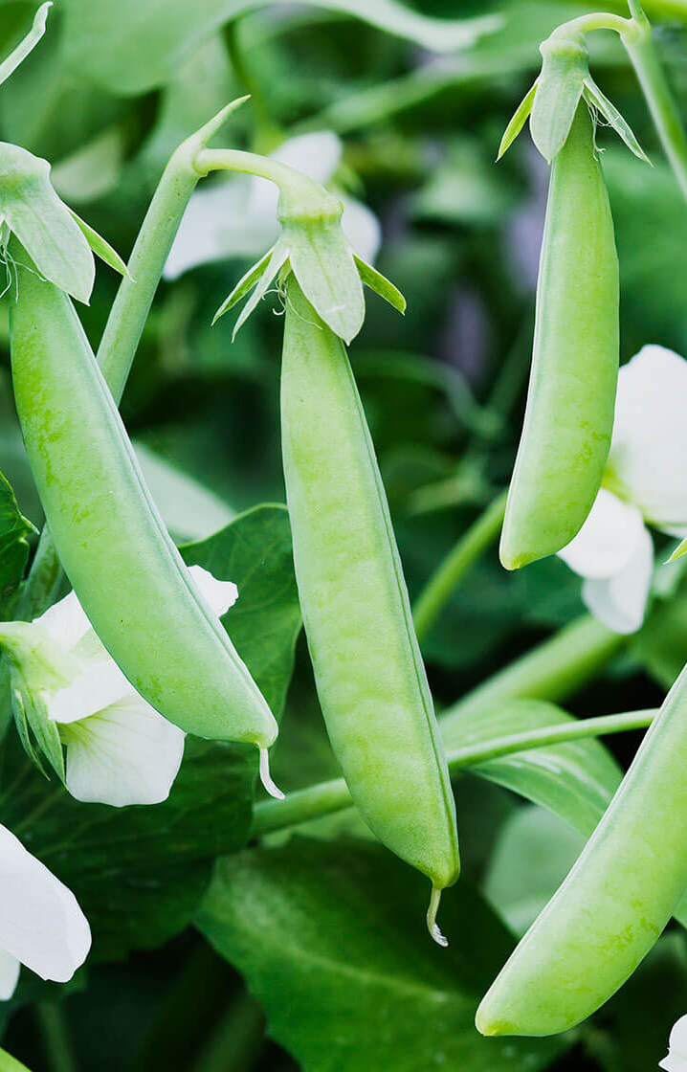
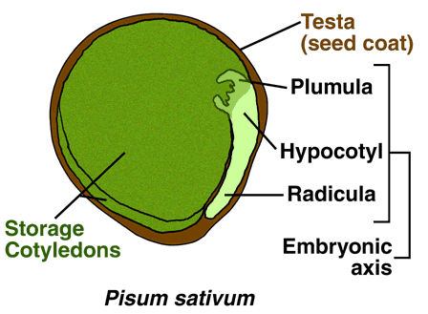
Part Of The Legume Family
Fabaceae is known as the Legume Family
Pisum is the genus
Pisum Sativum is the botanical name for edible-pod peas
Plants that produce pods enclosing fleshy edible seeds
Sugar Snap Peas are an edible-pod pea with rounded pods and thick pod walls
(pea/seed)
Notes:
https://www.saveur.com/inventor-sugar-snap-pea/
Family: collection of plants that share characteristics; Plants that flower and fruit in similar ways are considered to be part of the same family.
Genus: is the generic name, but not the species name.
Botanical: the scientific name given to a particular plant species.
Botany: the scientific study of plants, including their physiology, structure, genetics, ecology, distribution, classification, and economic importance.
Botanically, the pea pod is a fruit since it contains seeds which are the peas
Variety: is ranked under the botanical/species name & is a way to further classify the plant.
Pisum sativum var. marcrocarpon is the variety name of Sugar Snap Peas

Slide 3
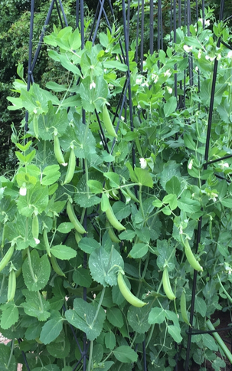
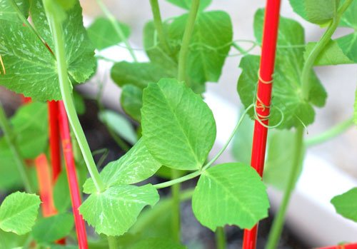

How Do Sugar Snap Pea Grow?
Sugar snap pea plants grow on vines! They climb on what's around, like fences
  Trellis or some kind of climbing support is needed
Sugar Snap pea plants grow small white flowers before producing the pods
They are cool season annual crops that grow best in climate between 60-70 degrees F (autumn, winter, early spring) with full sunlight & little water
They’re in season during April to November
Vine wrapped around trellis
Notes:
Sugar snap peas (​Pisum sativum​ var. ​macrocarpon​) are cool season annual crops that grow best when temperatures are between 60 and 70 degrees Fahrenheit.
In mild, coastal areas, these crops can be grown from November to February or March. The blossoms are small in size and detail, but they produce sweet, delicious peas. Vining snap pea need a structure to climb on. Sugar snap peas grow on a vine that climbs up a fence or trellis. The vine grows quickly, wrapping tendrils around the trellis as it climbs higher. Small white flowers form on the vine and when these are pollinated, the pea pods begin to form. Eventually the flowers drop off and the peas are soon mature enough to harvest.

Slide 4

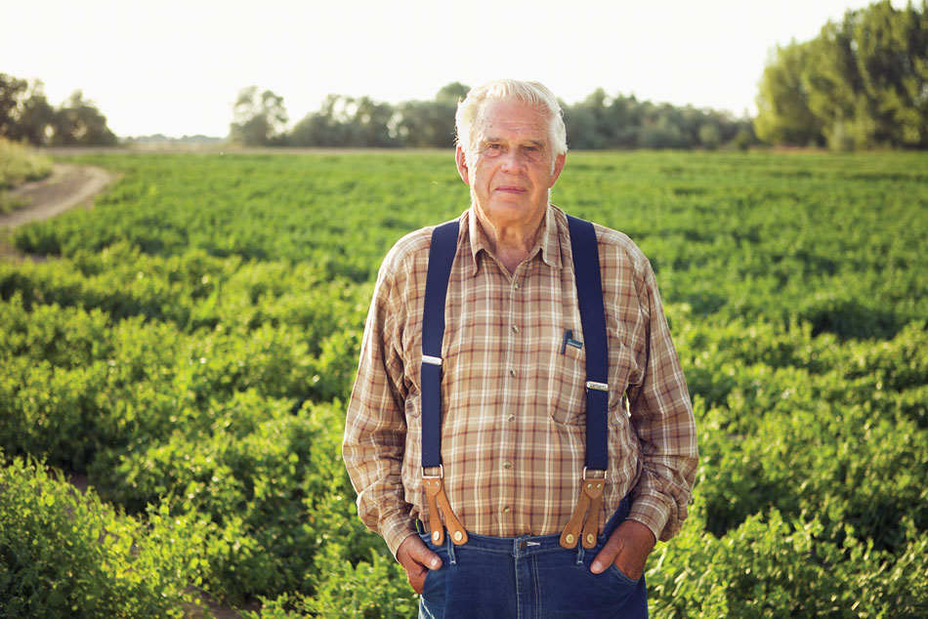
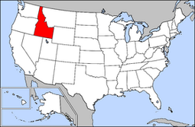
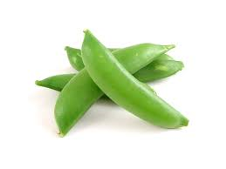
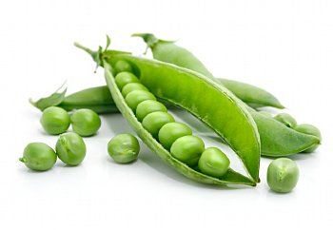
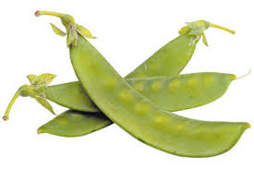
Origin
Dr. Calvin Lamborn “Father of the Sugar Snap Pea” is a plant breeder with a PhD in plant virology
Dr. Calvin Lamborn
He invented sugar snap peas in Idaho in 1979 by crossing garden peas with snow peas to get sugar snap pea!
Garden Pea
(pod is not edible)
Snow Pea
(edible pod with flat peas)
Sugar Snap Pea
(edible pod with round peas)
Notes:
https://blog.thenibble.com/2018/04/07/tip-of-the-day-sugar-snap-peas-2/
Peas photo cred + info: https://nutritionknowhow.org/blog/c/peas-what-is-the-difference/
http://www.eatmorepeas.com/ABUS.html
Photo cred + info: https://www.lamag.com/digestblog/meet-calvin-lamborn-the-inventor-of-the-sugar-snap-pea/

Slide 5
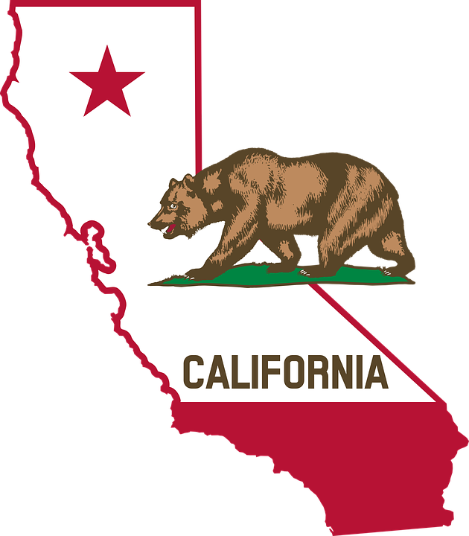
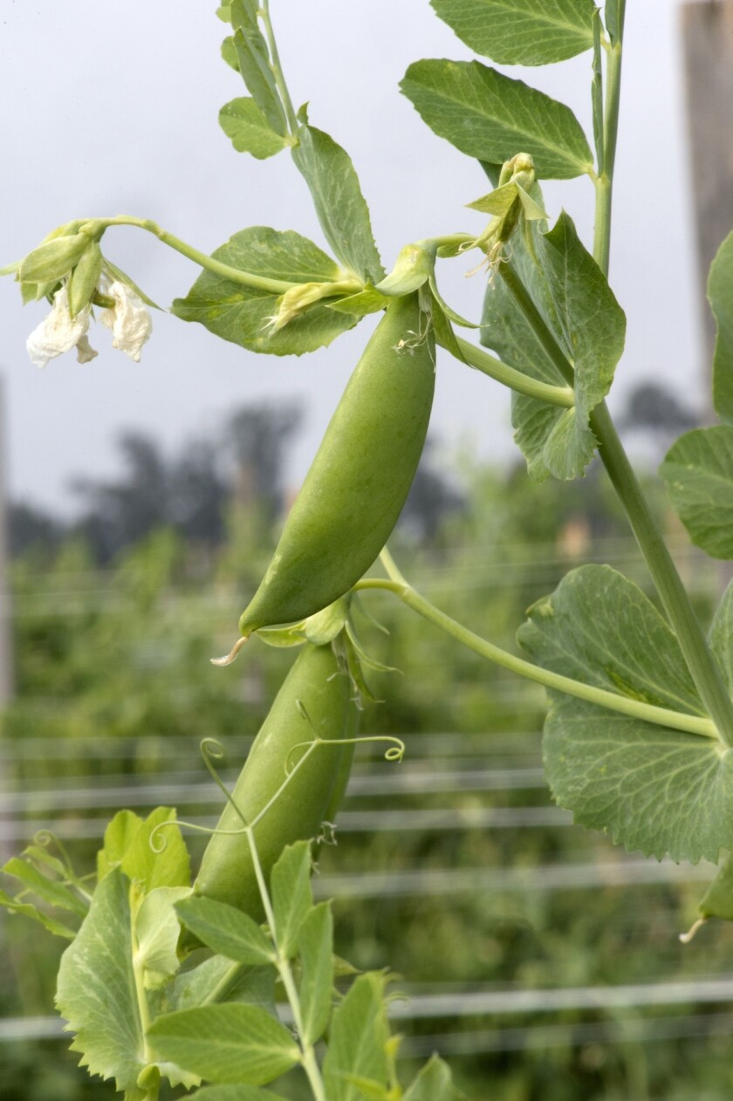
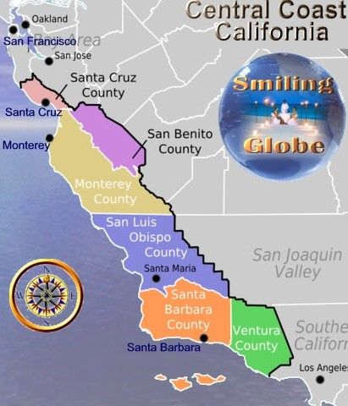
Homegrown in California
Edible-pod peas are grown year-round in Santa Barbara & San Luis Obispo Counties
They require cool growing conditions & do not produce well in very hot areas
Santa Barbara, San Luis Obispo, Monterey & Stanislaus are the top producing counties in CA growing more than 80% of the state’s supply
Sugar Snap Peas are typically grown as a spring plant in cooler weather like Northern California (April to November) & grow best in late winter before the warm summer in regions like Southern California (January to May).
Notes:
https://seasonalfoodguide.org/veg/snap-peas/southern-california
Harvest of the Month:
Homegrown Facts
Edible-pod peas are grown year-round in Santa Barbara and San Luis Obispo counties.
Santa Barbara, San Luis Obispo, Monterey, and Stanislaus counties are the top four producing counties in California, growing more than 80% of the state’s supply.
Just the Facts
The sugar snap pea is actually a hybrid of green and snow peas. It was developed in 1979 to make an edible-pod variety with sweeter, full-sized peas.
Edible-pod peas were specifically bred so that the pods’ fibers go in one direction, allowing them to be chewed.
Today only 5% of all peas grown are sold fresh; over half are canned and most of the rest are frozen.
https://gregalder.com/yardposts/growing-peas-in-southern-california/
https://homeguides.sfgate.com/grow-bush-sugar-snaps-21046.html
They are typically grown as a spring plant in cooler Norther California location. In wetter coastal regions with warm summers, they grow best in late winter but before the warm summer. Hence they are in season April to November in cooler locations but are in season January- May in southern CA
https://anrcatalog.ucanr.edu/pdf/7233.pdf

Slide 6
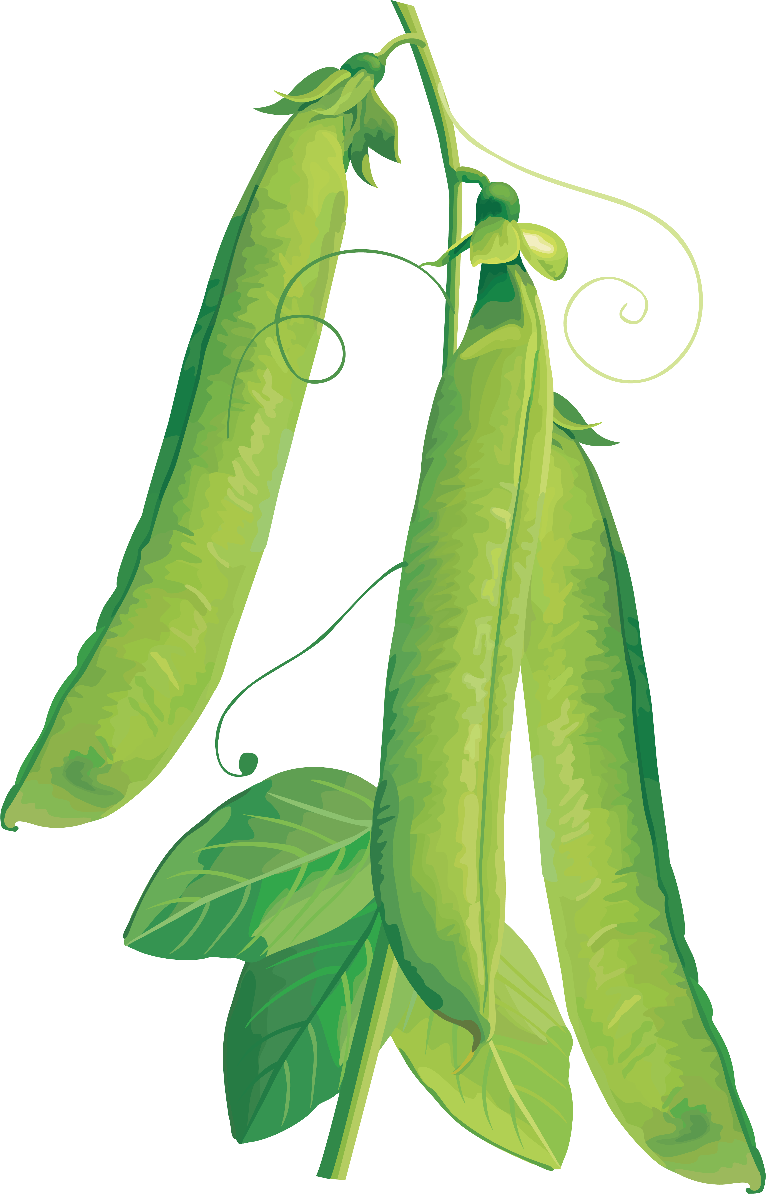
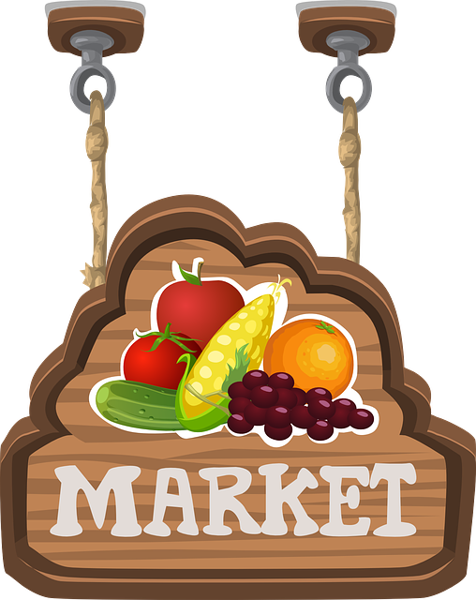
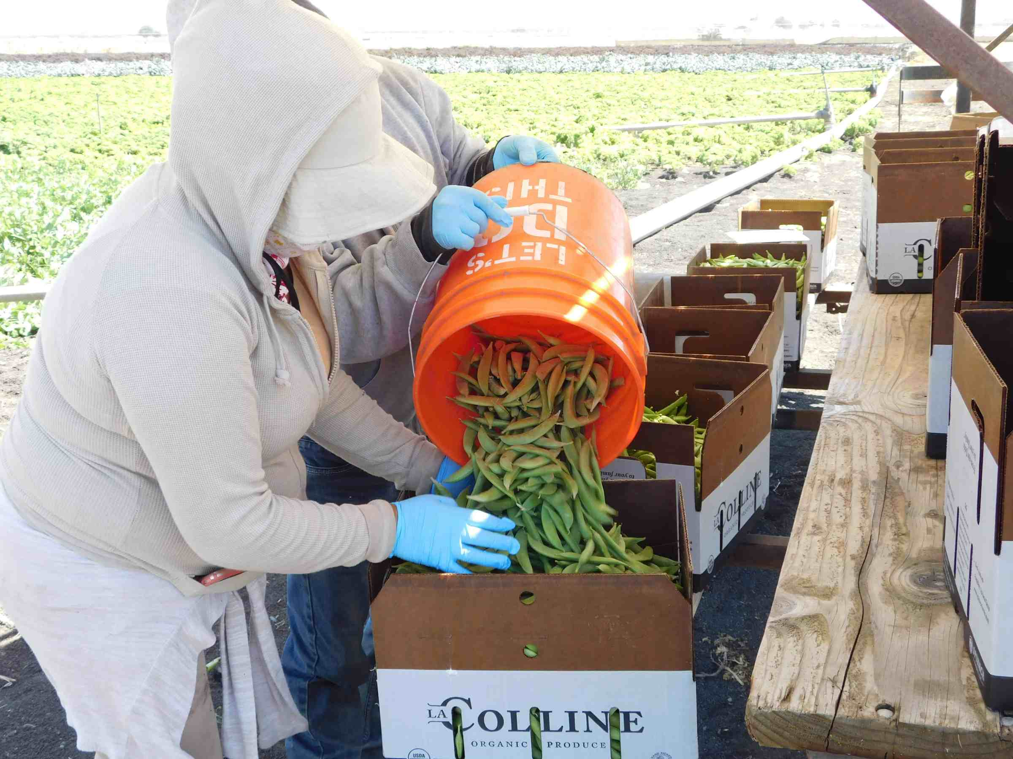
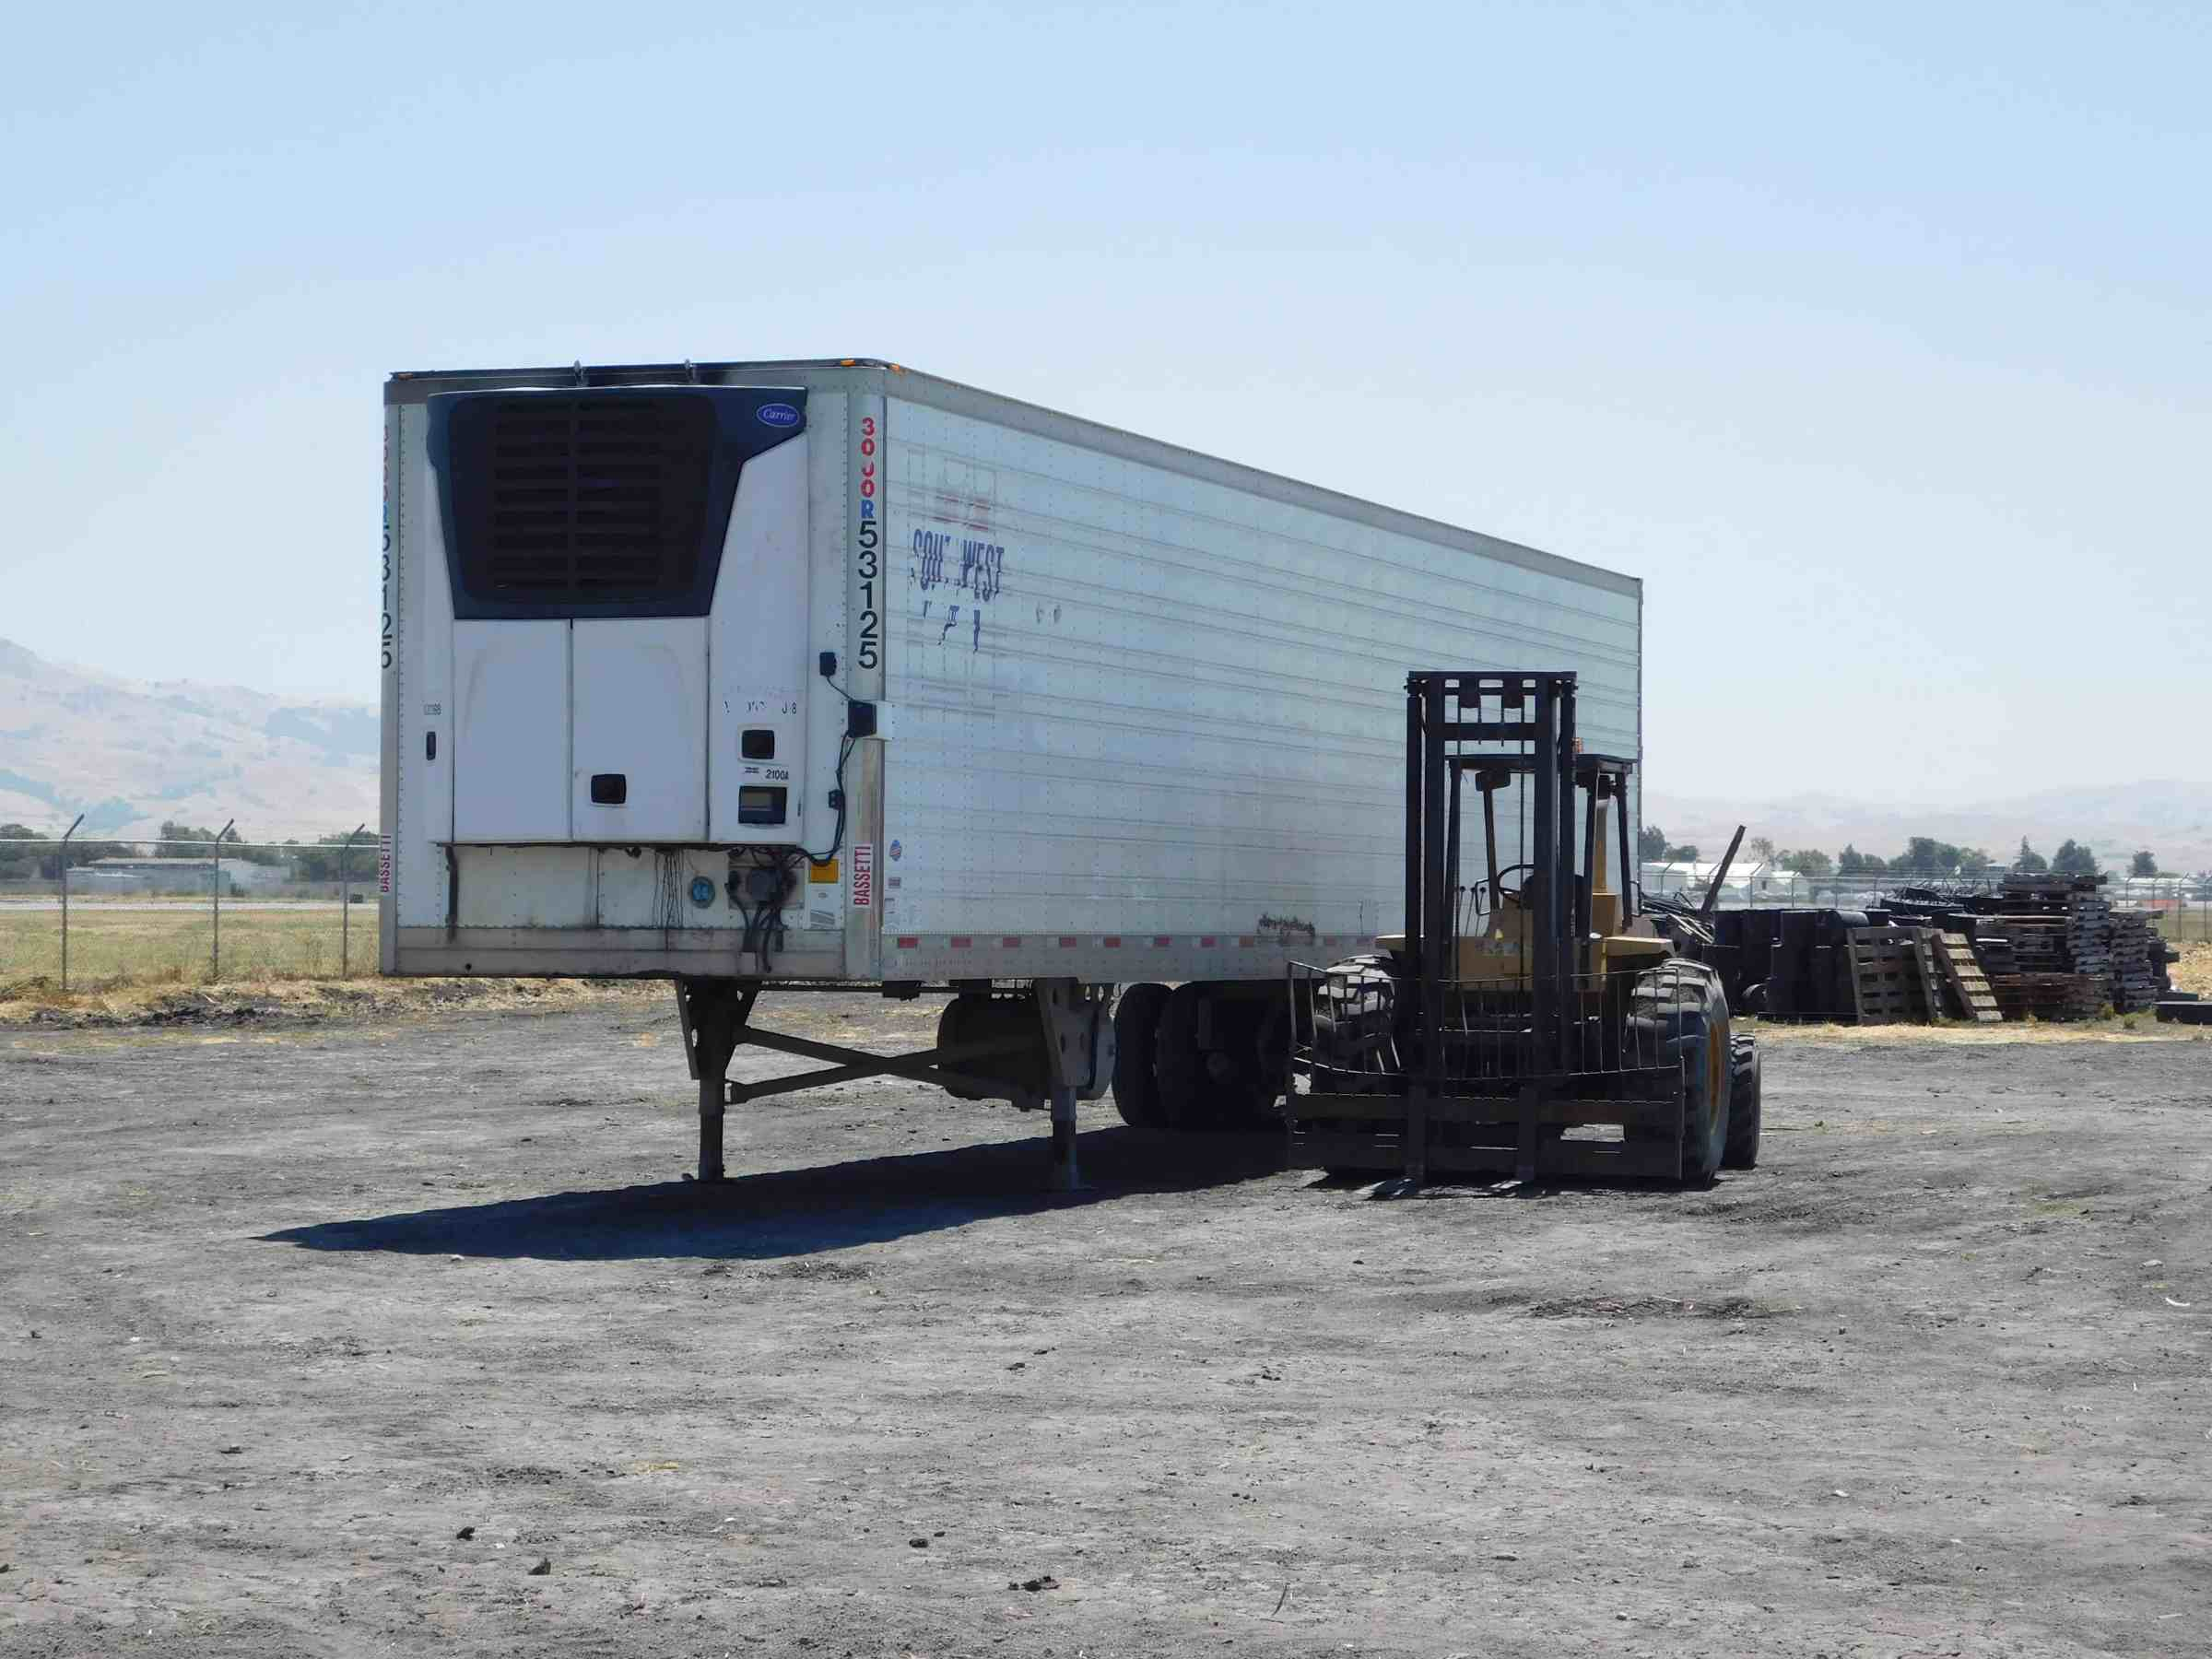
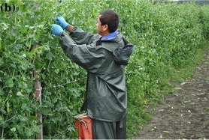
From Field to Store
Harvesters move through the sugar snap pea field picking mature, ready-to-harvest pods & leaving the immature pods to grow until maturation
Once their 5 lb bucket is full, the harvesters take it to the quality control station for quality inspection
After inspection, pallets full of quality sugar snap pea are loaded into a reefer (refrigerated trailer) to keep cool & wait for transportation
Notes:
https://www.theproducenerd.com/2017/09/how-sugar-snap-peas-are-harvested/

Slide 7
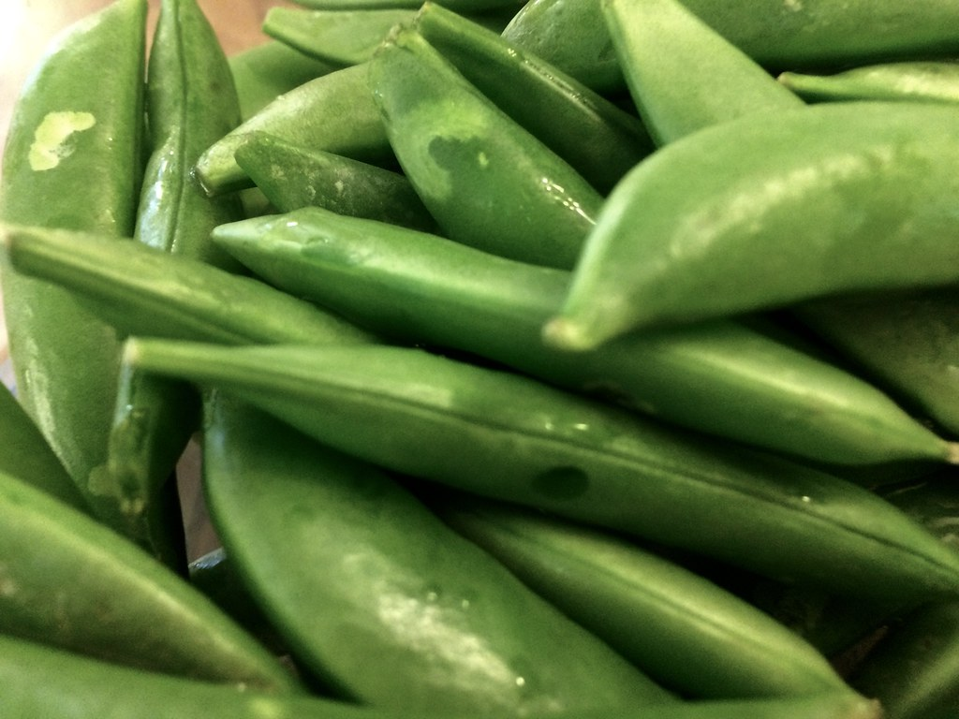

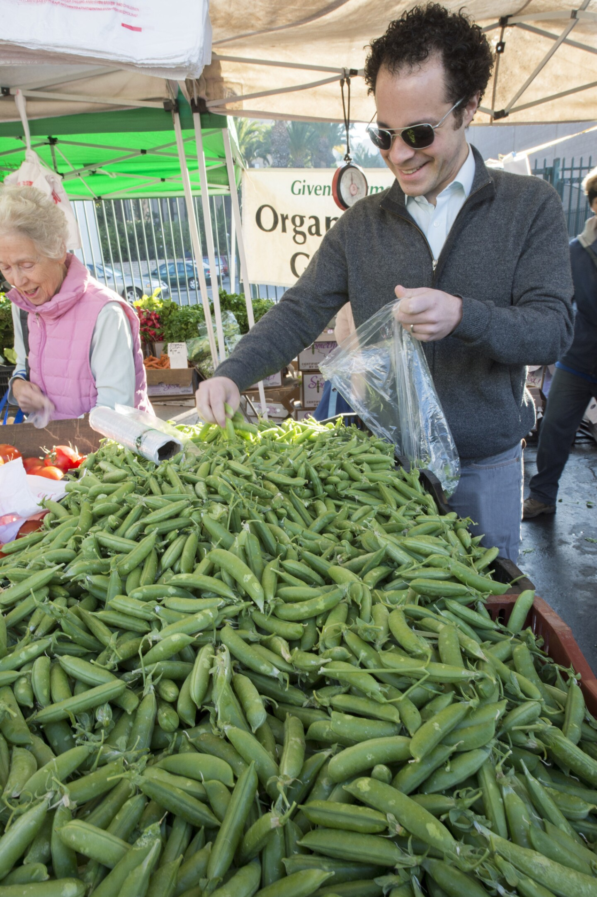
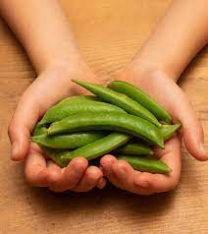
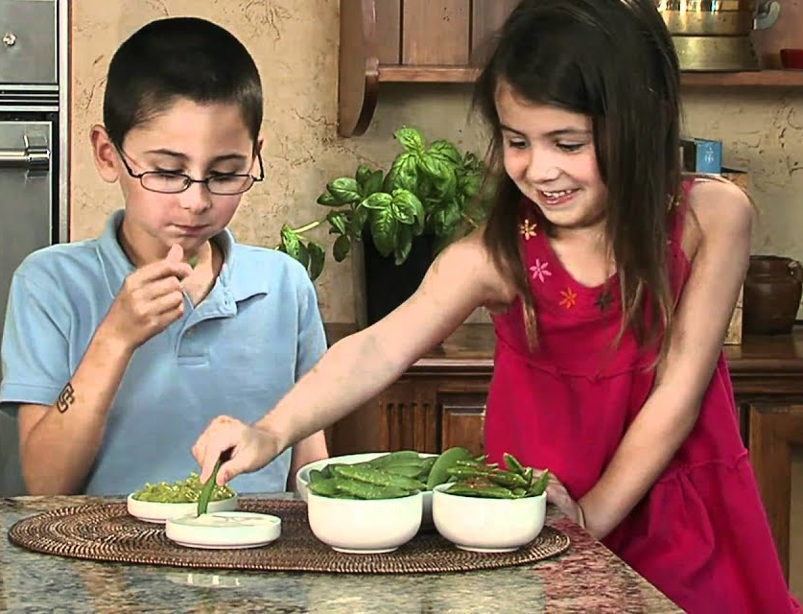
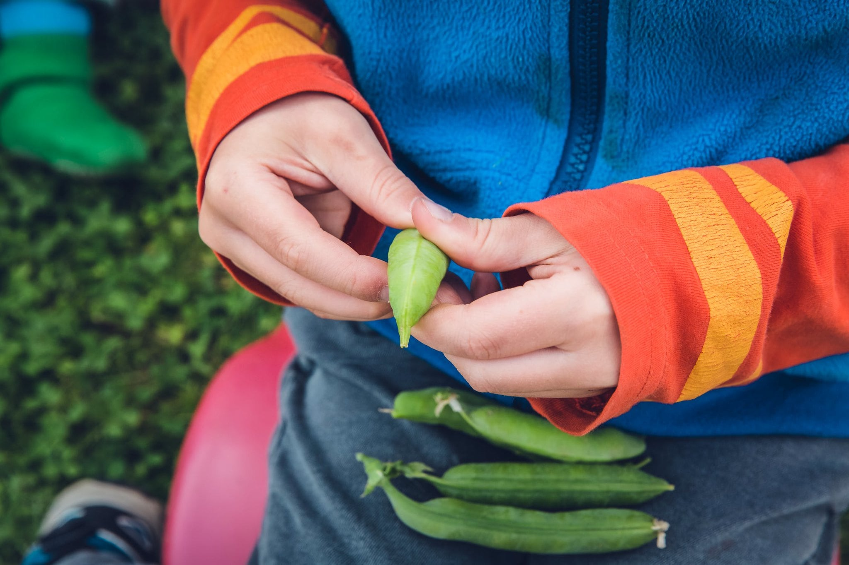
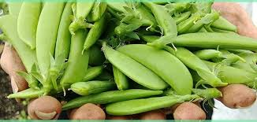
How to Pick Them
Look for bright green sugar snap pea pods, free of blemishes or without many marks
Feel for firm, smooth & plump pods
Smell for freshness
Taste is crispy sweet
Notes:
https://nutritionknowhow.org/blog/c/peas-what-is-the-difference/

Slide 8
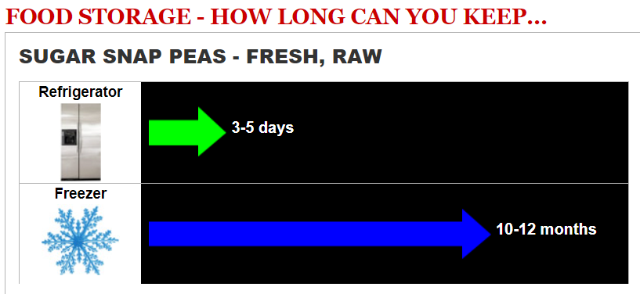
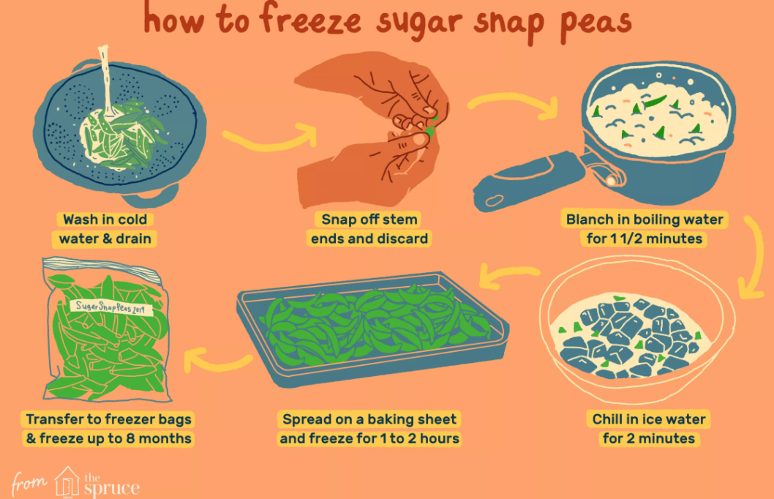
How to Store & Wash Them
Keep fresh sugar snap peas refrigerated for up to 3-5 days & do not wash until ready to use
Keep them in the freezer to last longer (8 to 12 months)
To freeze them: wash well, snap off stem ends, get a large bowl of ice ready for blanching
Blanching slows or stops enzyme activity
Enzyme action can cause loss of flavor, color, texture & nutrients
How to blanch sugar snap peas:
Need: 1 pot of boiling water & 1 bowl of ice water
Drop them into a pot of boiling water & cook for 1 ½ minutes
Immediately cool them in the ice water bath for 2 minutes to stop the cooking process
Pack them in an air-tight container & store them in the freezer
Notes:
https://www.stilltasty.com/fooditems/index/17948
https://extension.umn.edu/preserving-and-preparing/vegetable-blanching-directions-and-times-home-freezer-storage
Discuss blanching by connecting science with cooking.
Nutrients are vitamins & minerals that help our body function.

Slide 9
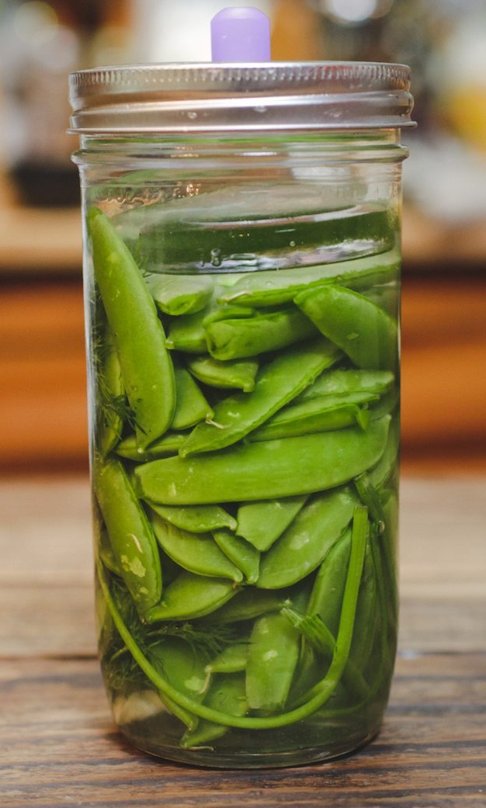
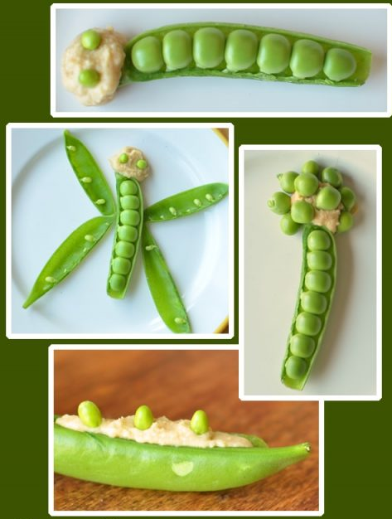
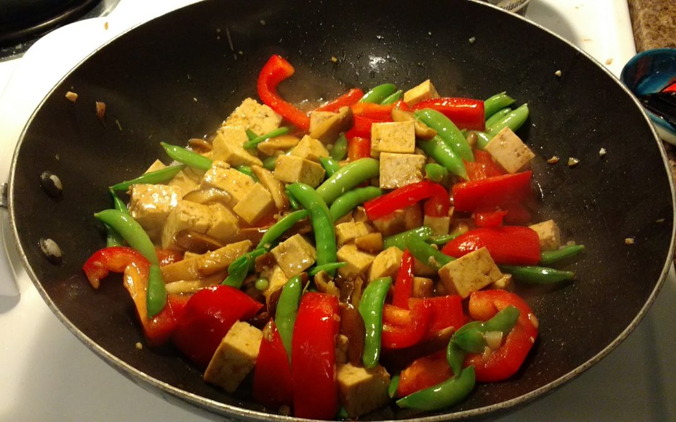
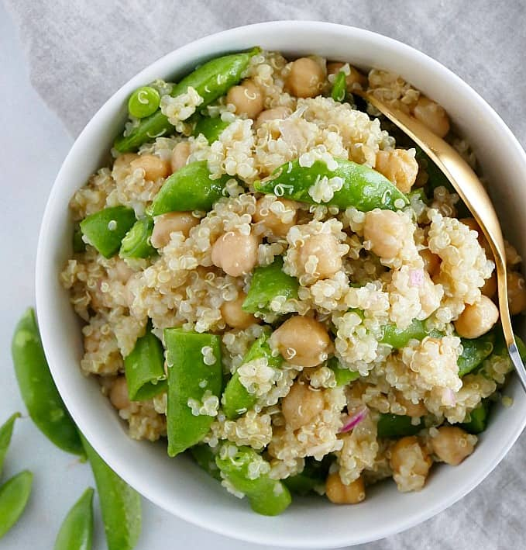
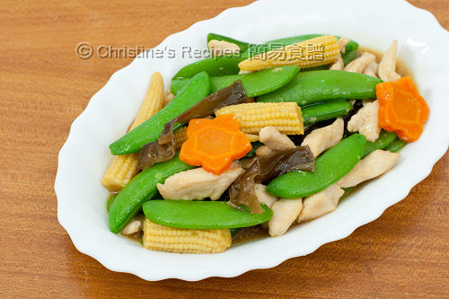
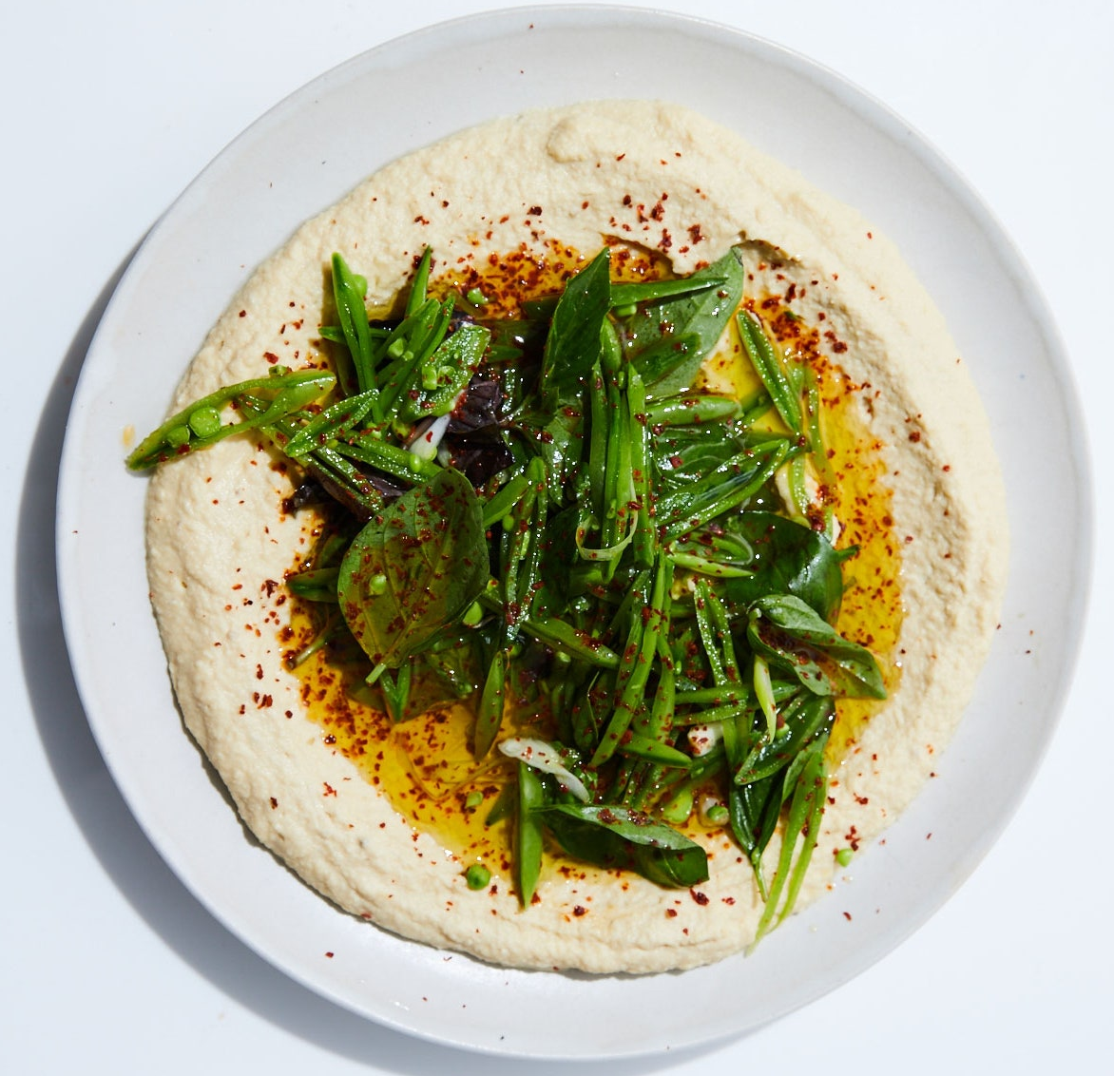
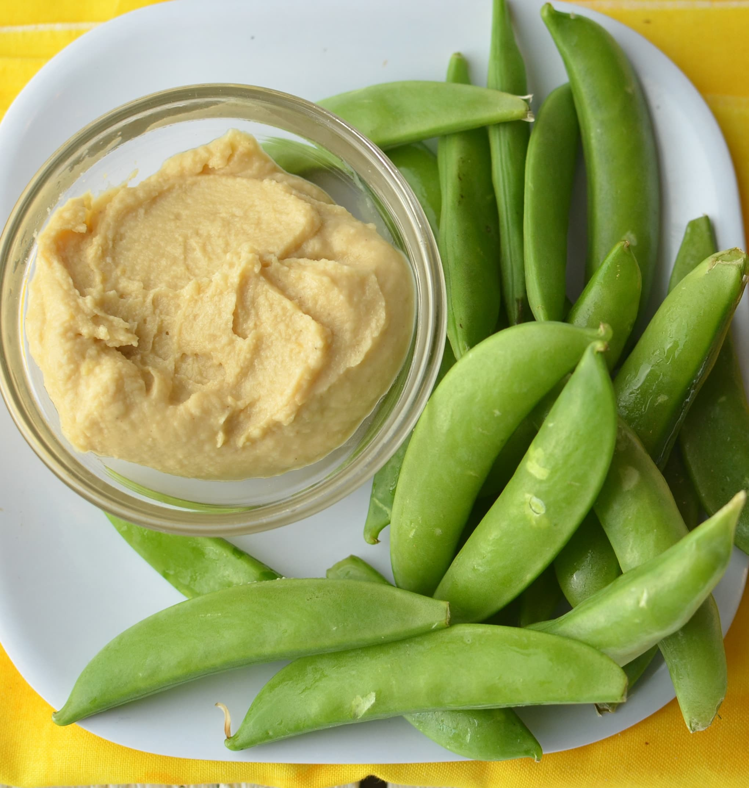
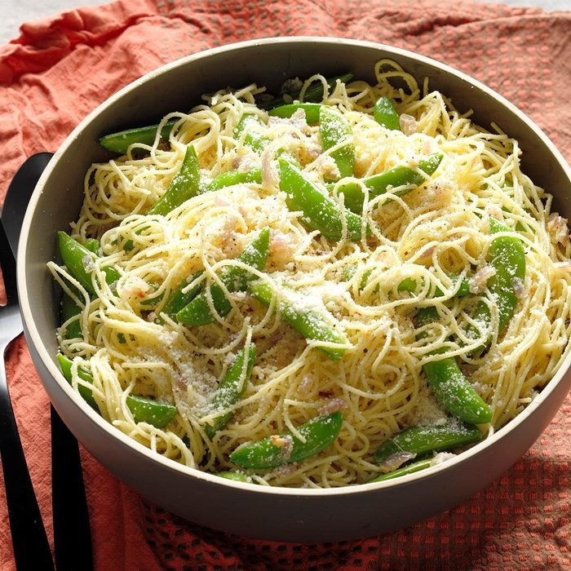
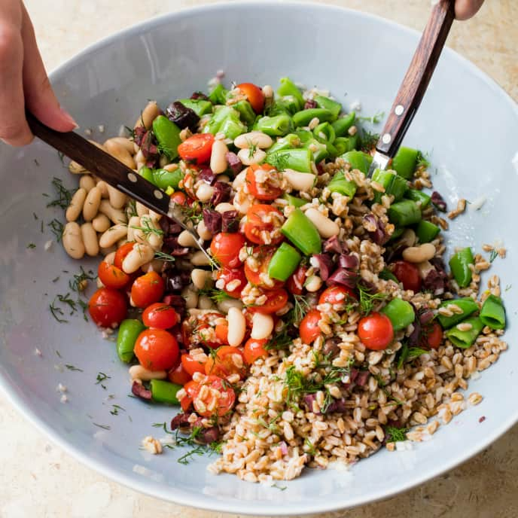
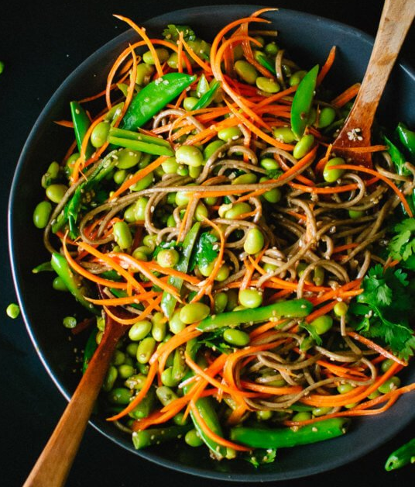
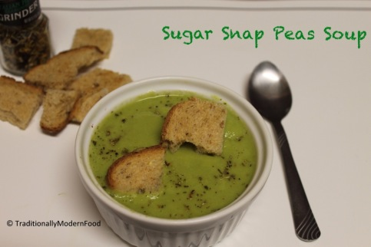
Ways to Eat Sugar Snap Peas
Eat them Raw
or
Briefly Cooked
With hummus, quinoa, beans or other protein-rich plant foods to make it a complete protein meal
Stir-fry, blanch, roast, or puree into soup to keep it nutrient-dense
Notes:
https://health.clevelandclinic.org/do-i-need-to-worry-about-eating-complete-proteins/
A food is considered a complete protein when it contains the nine essential amino acids that our body cannot produce on its own.
https://healthyeating.sfgate.com/much-protein-serving-snap-peas-6886.html
Although snap peas contribute to your overall protein intake, their protein isn't complete. This means that they don't have all of the essential amino acids your body has to have in order to function. Meat, fish, seafood, dairy and eggs are complete protein sources, since they have all of the essential amino acids in one sourceincomplete. While you can easily get all of the essential amino acids you need strictly from plant proteins, you'll have to fill your diet with a variety of different types throughout the day. For example, enjoying a side of brown rice with sauteed snap peas helps your body get all of the essential amino acids, all on one plate.
Nutrient-dense: packed with nutrients! / Full of nutrients!
Overcooking may cause lose of nutrients.
Recipes & pic credit links:
https://www.bonappetit.com/recipe/hummus-with-sugar-snap-peas-and-basil
https://www.superhealthykids.com/recipes/sugar-snaps-n-hummus/
https://www.superhealthykids.com/recipes/sugar-snap-boats-bugs-and-butterflies/
https://itsavegworldafterall.com/snap-pea-quinoa-salad/
https://cookieandkate.com/sugar-snap-pea-and-carrot-soba-noodles/
https://traditionallymodernfood.wordpress.com/2014/06/29/sugar-snap-peas-soup-2/
https://www.americastestkitchen.com/recipes/12496-vegan-farro-salad-with-sugar-snap-peas-and-white-beans
https://agriberry.com/szes-famous-sugar-snap-pea-stir-fry/
https://en.christinesrecipes.com/2011/04/stir-fried-sugar-snap-peas-with-chicken.html
https://www.mountainfeed.com/blogs/learn/129924615-fermented-snap-pea-recipe
. Get the rest of the essential amino acids you need by pairing incomplete proteins. Protein-rich plant foods, like nuts, beans, whole grains and tofu, are all

Slide 10
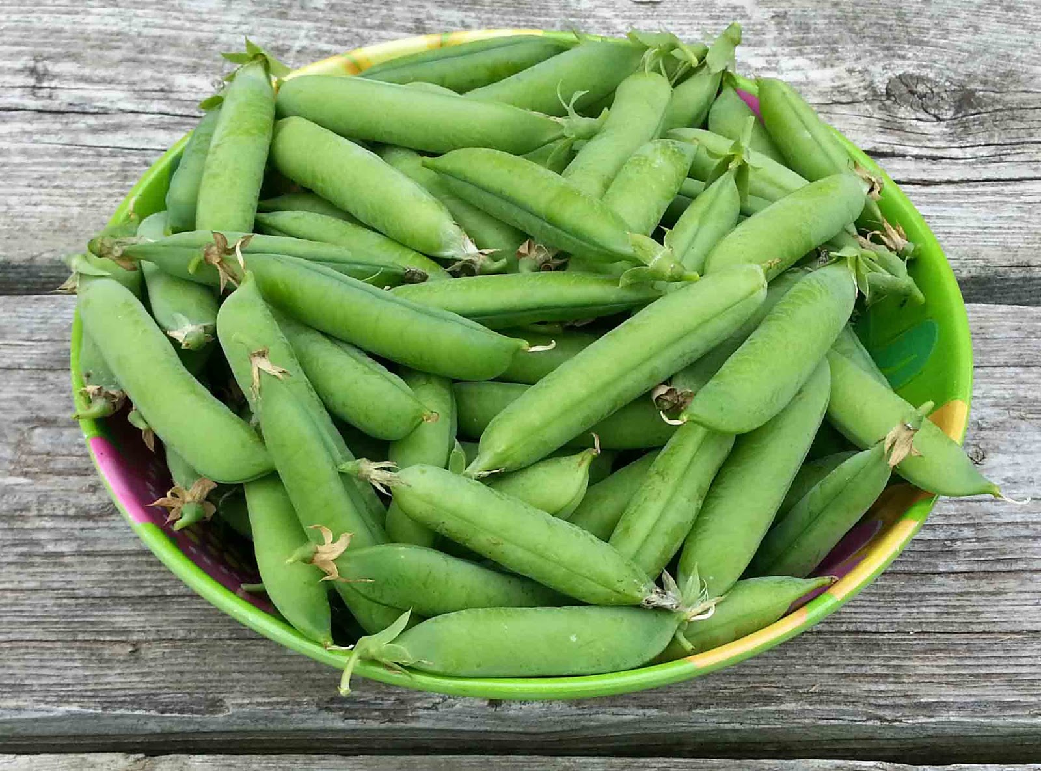
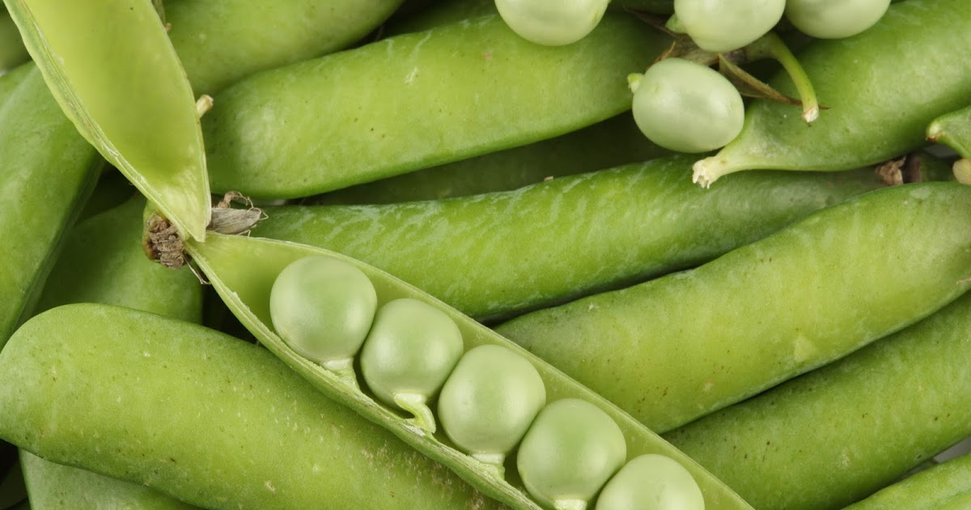

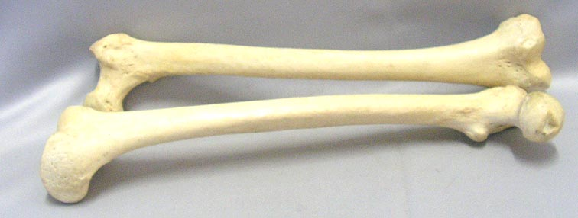

Oh Snap!
Sugar Snap Peas are high in:
Vitamin K, A & C
Strengthens the immune system
Important for skin & eye health
Good for the heart & bones
Sugar Snap Peas have fiber
Fiber is a nutrient that helps with digestion & keeps us from being hungry

Slide 11
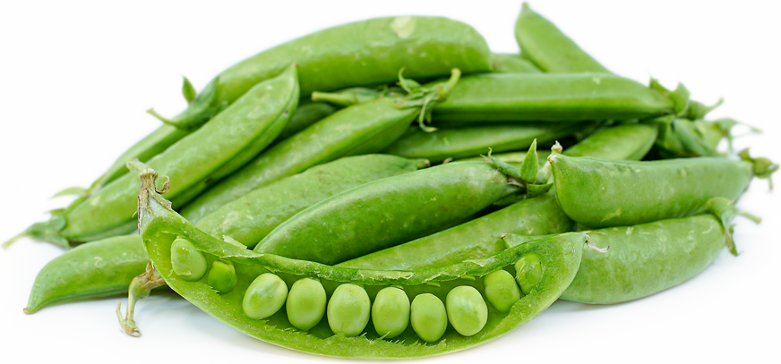
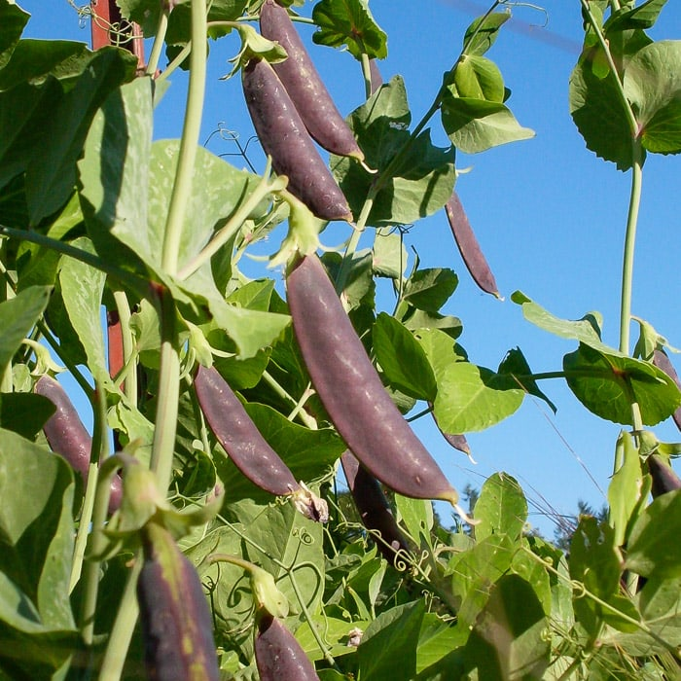
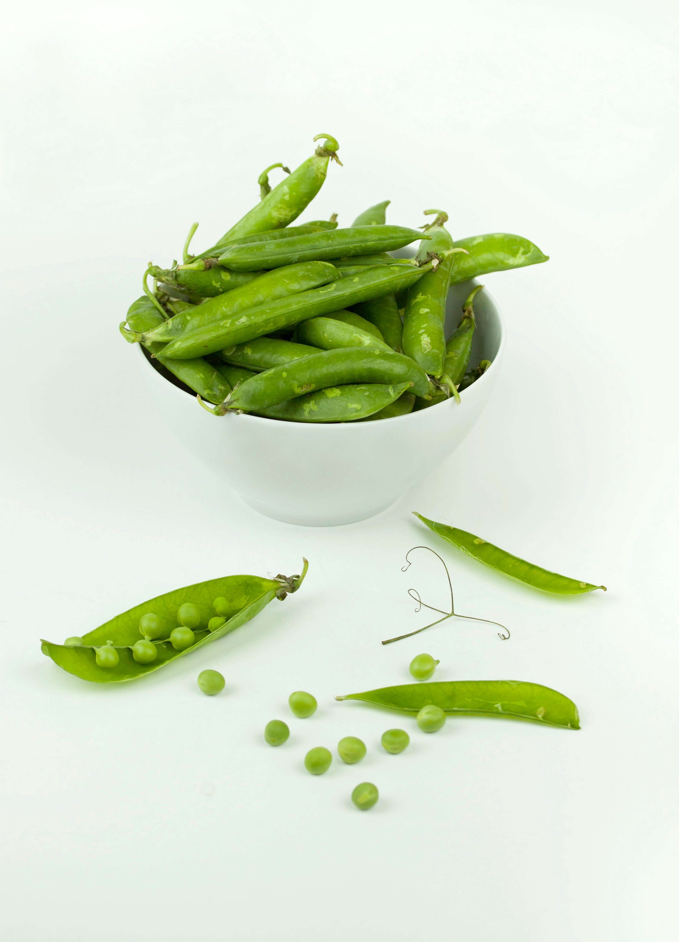

Fun Facts
You can eat all parts of the sugar snap pea. The pods are edible!
Edible-pod peas are referred to as:
Mange tout- a French term meaning “eat all”
& snapping peas for how they can be snapped & eaten like green beans
Botanically, the pod is the fruit & the peas are the seeds
Sugar snap peas can be purple!
Notes:
Throughout much of the world, edible-pod peas are referred to as mange tout, a French term meaning “eat all.” They are also nicknamed snapping peas for how they can be “snapped” and eaten like green beans.
Botanically, the pod is the fruit & the peas are the seeds.
Although Sugar Snap Pea was born in our century, history has it that they were around years & years ago but went extinct. Dr. brought them back to life.

Slide 12
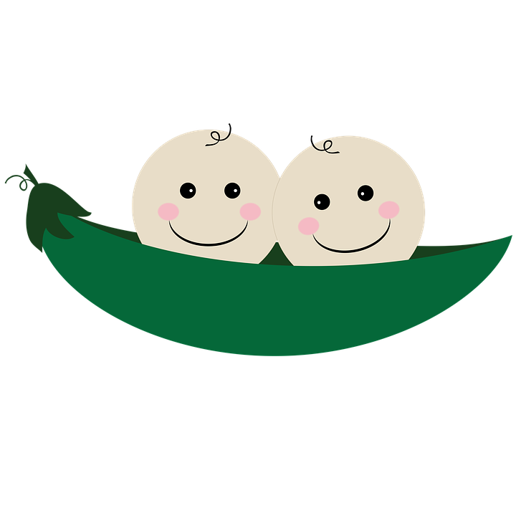
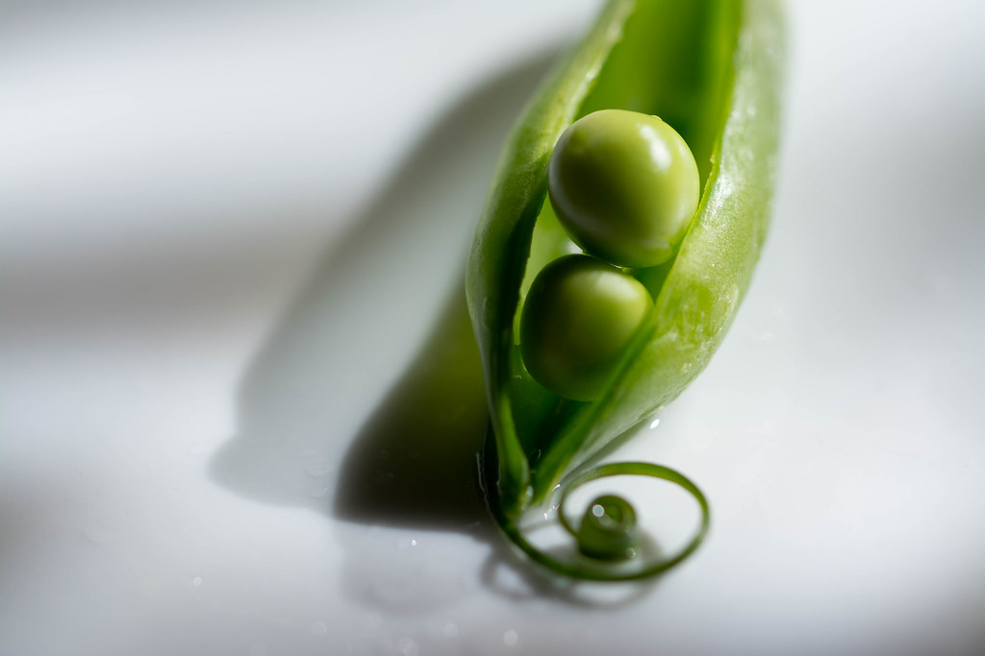
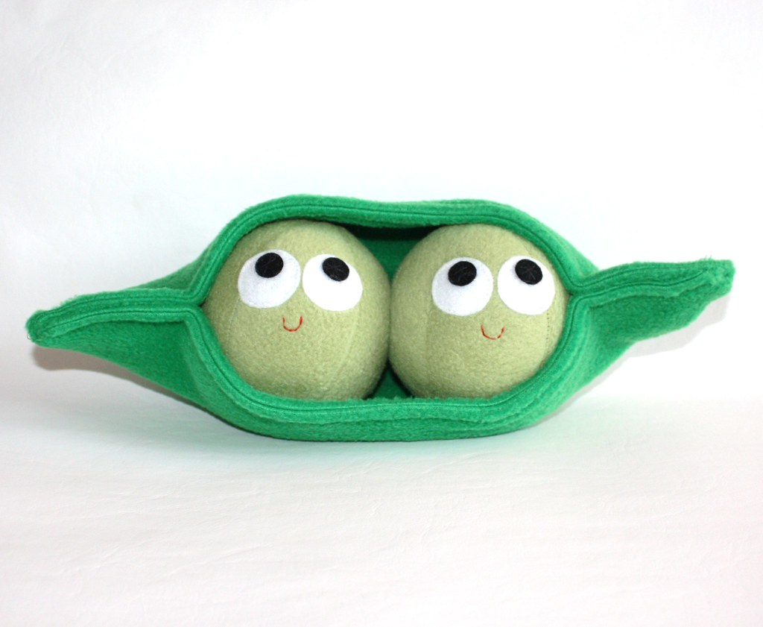
Fun Facts
Have you heard the phrase:
Two Peas in a Pod
Two peas inside of a pod are nearly identical
This phrase has been used for 200+ years!
It’s used to describe two people who share similarities
Notes:
Two Peas in a Pod!!
https://knowyourphrase.com/two-peas-in-a-pod
The phrase stems from the fact that two peas inside of a pod are nearly identical.

Slide 13
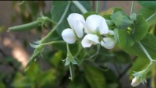
Sugar Snap Pea
https://youtu.be/A9q6ccJ0DgE
~ 4 min informative video of backyard Sugar Snap Peas in Los Angeles, California
Notes:
https://youtube/A9q6ccJ0DgE

Slide 14
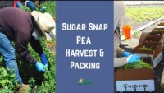
Sugar Snap Pea
https://www.youtube.com/watch?v=thrb1KwSD2Q
Less than 2 min video of a Sugar Snap Pea harvest at a farm in Northern California
Notes:
https://www.youtube.com/watch?v=thrb1KwSD2Q

Slide 15
References
Britannica
https://www.britannica.com/plant/pea
Calvin’s Peas
http://www.eatmorepeas.com/ABUS.html
Cleveland Clinic
https://health.clevelandclinic.org/do-i-need-to-worry-about-eating-complete-proteins/
Edible Pod Pea Collection in California
https://anrcatalog.ucanr.edu/pdf/7233.pdf
Harvest of the Month
https://harvestofthemonth.cdph.ca.gov/documents/Spring/Peas/Peas%20-%20Educator%27s%20Newsletter_Final.pdf
Know Your Phrase
https://knowyourphrase.com/two-peas-in-a-pod
LA Magazine
https://www.lamag.com/digestblog/meet-calvin-lamborn-the-inventor-of-the-sugar-snap-pea/

Slide 16
References
Nutrition Know How
https://nutritionknowhow.org/blog/c/peas-what-is-the-difference/
Saveur
https://www.saveur.com/inventor-sugar-snap-pea/
Seasonal Food Guide
https://seasonalfoodguide.org/veg/snap-peas/southern-california
SF Gate
https://homeguides.sfgate.com/grow-bush-sugar-snaps-21046.html
https://homeguides.sfgate.com/long-flower-picking-peas-58805.html
Smarty Plants
https://smartyplants.com.au/2012/09/sugar-snap-peas/
Specialty Produce
https://www.specialtyproduce.com/produce/Pea_Tendrils_3990.php
Still Tasty
https://www.stilltasty.com/fooditems/index/17948
Notes:
https://www.stilltasty.com/fooditems/index/17948
https://extension.umn.edu/preserving-and-preparing/vegetable-blanching-directions-and-times-home-freezer-storage
https://nutritionknowhow.org/blog/c/peas-what-is-the-difference/
https://www.theproducenerd.com/2017/09/how-sugar-snap-peas-are-harvested/
https://gregalder.com/yardposts/growing-peas-in-southern-california/
https://homeguides.sfgate.com/grow-bush-sugar-snaps-21046.html
https://anrcatalog.ucanr.edu/pdf/7233.pdf
https://blog.thenibble.com/2018/04/07/tip-of-the-day-sugar-snap-peas-2/
Peas photo cred + info: https://nutritionknowhow.org/blog/c/peas-what-is-the-difference/
https://www.saveur.com/inventor-sugar-snap-pea/
https://smartyplants.com.au/2012/09/sugar-snap-peas/
https://harvestofthemonth.cdph.ca.gov/documents/Spring/Peas/Peas%20-%20Educator%27s%20Newsletter_Final.pdf
https://www.britannica.com/plant/pea
https://homeguides.sfgate.com/long-flower-picking-peas-58805.html
https://www.specialtyproduce.com/produce/Pea_Tendrils_3990.php
http://www.eatmorepeas.com/ABUS.html
Photo cred + info: https://www.lamag.com/digestblog/meet-calvin-lamborn-the-inventor-of-the-sugar-snap-pea/
https://seasonalfoodguide.org/veg/snap-peas/southern-california
https://knowyourphrase.com/two-peas-in-a-pod
https://healthyeating.sfgate.com/much-protein-serving-snap-peas-6886.html
https://health.clevelandclinic.org/do-i-need-to-worry-about-eating-complete-proteins/
Recipes & pic credit links:
https://www.bonappetit.com/recipe/hummus-with-sugar-snap-peas-and-basil
https://www.superhealthykids.com/recipes/sugar-snaps-n-hummus/
https://www.superhealthykids.com/recipes/sugar-snap-boats-bugs-and-butterflies/
https://itsavegworldafterall.com/snap-pea-quinoa-salad/
https://cookieandkate.com/sugar-snap-pea-and-carrot-soba-noodles/
https://traditionallymodernfood.wordpress.com/2014/06/29/sugar-snap-peas-soup-2/
https://www.americastestkitchen.com/recipes/12496-vegan-farro-salad-with-sugar-snap-peas-and-white-beans
https://agriberry.com/szes-famous-sugar-snap-pea-stir-fry/
https://en.christinesrecipes.com/2011/04/stir-fried-sugar-snap-peas-with-chicken.html
https://www.mountainfeed.com/blogs/learn/129924615-fermented-snap-pea-recipe

Slide 17
References
The Nibble
https://blog.thenibble.com/2018/04/07/tip-of-the-day-sugar-snap-peas-2
The Produce Nerd
https://www.theproducenerd.com/2017/09/how-sugar-snap-peas-are-harvested/
The Yard Post
https://gregalder.com/yardposts/growing-peas-in-southern-california/
Notes:
https://www.stilltasty.com/fooditems/index/17948
https://extension.umn.edu/preserving-and-preparing/vegetable-blanching-directions-and-times-home-freezer-storage
https://nutritionknowhow.org/blog/c/peas-what-is-the-difference/
https://www.theproducenerd.com/2017/09/how-sugar-snap-peas-are-harvested/
https://gregalder.com/yardposts/growing-peas-in-southern-california/
https://homeguides.sfgate.com/grow-bush-sugar-snaps-21046.html
https://anrcatalog.ucanr.edu/pdf/7233.pdf
https://blog.thenibble.com/2018/04/07/tip-of-the-day-sugar-snap-peas-2/
Peas photo cred + info: https://nutritionknowhow.org/blog/c/peas-what-is-the-difference/
https://www.saveur.com/inventor-sugar-snap-pea/
https://smartyplants.com.au/2012/09/sugar-snap-peas/
https://harvestofthemonth.cdph.ca.gov/documents/Spring/Peas/Peas%20-%20Educator%27s%20Newsletter_Final.pdf
https://www.britannica.com/plant/pea
https://homeguides.sfgate.com/long-flower-picking-peas-58805.html
https://www.specialtyproduce.com/produce/Pea_Tendrils_3990.php
http://www.eatmorepeas.com/ABUS.html
Photo cred + info: https://www.lamag.com/digestblog/meet-calvin-lamborn-the-inventor-of-the-sugar-snap-pea/
https://seasonalfoodguide.org/veg/snap-peas/southern-california
https://knowyourphrase.com/two-peas-in-a-pod
https://healthyeating.sfgate.com/much-protein-serving-snap-peas-6886.html
https://health.clevelandclinic.org/do-i-need-to-worry-about-eating-complete-proteins/
Recipes & pic credit links:
https://www.bonappetit.com/recipe/hummus-with-sugar-snap-peas-and-basil
https://www.superhealthykids.com/recipes/sugar-snaps-n-hummus/
https://www.superhealthykids.com/recipes/sugar-snap-boats-bugs-and-butterflies/
https://itsavegworldafterall.com/snap-pea-quinoa-salad/
https://cookieandkate.com/sugar-snap-pea-and-carrot-soba-noodles/
https://traditionallymodernfood.wordpress.com/2014/06/29/sugar-snap-peas-soup-2/
https://www.americastestkitchen.com/recipes/12496-vegan-farro-salad-with-sugar-snap-peas-and-white-beans
https://agriberry.com/szes-famous-sugar-snap-pea-stir-fry/
https://en.christinesrecipes.com/2011/04/stir-fried-sugar-snap-peas-with-chicken.html
https://www.mountainfeed.com/blogs/learn/129924615-fermented-snap-pea-recipe

